Slide 1
ANATOLIA KEBAB HOUSE
Wayne Location
Performance Review
Internal review prepared by Jason Rivera with Frank Moretti, CPA
Fiscal year 2025 . Paterson and Wayne, New Jersey

Slide 2
WHERE WE STAND
Two kitchens, one standard
$1.05M
Main Street revenue
the 2012 original, lunch driven
$750K
Wayne revenue
opened 2021, dinner driven, growing
$1.8M
Combined 2025
up 16% from $1.55M in 2024
The question for 2025: Wayne carries 42% of revenue on a more modern room that seats 75, yet weekday foot traffic still lags Main Street. The plan that follows is built to close that gap without touching the quality of the food.
2 / 8

Slide 3
SALES TREND
Monthly food sales by location
Net sales in thousands. Both locations peak into summer patio season and December catering.
3 / 8

Slide 4
THE BOOKS
Profit and loss, full year 2025
Line item | Main Street | Wayne | Combined
Total revenue | $1,050,000 | $750,000 | $1,800,000
Cost of goods sold (30%) | $315,000 | $225,000 | $540,000
Gross profit | $735,000 | $525,000 | $1,260,000
Labor (34%) | $357,000 | $255,000 | $612,000
Rent and occupancy | $36,000 | $57,600 | $93,600
Other operating | $67,400 | $52,300 | $119,700
Net operating income | $274,600 | $160,100 | $434,700
Wayne rent of $57,600 a year ($4,800 a month) is the heaviest fixed cost on that location.
4 / 8

Slide 5
COST PRESSURE
Food cost and the price of lamb
Lamb climbed from $6.10 to $7.40 a pound. Food cost sits at 30% against a 28% target, held there by quality not waste.
5 / 8

Slide 6
THE GAP
Weekday dinner covers at Wayne
Monday to Thursday covers
target 90
Online ordering share
target 40
Repeat guest rate
target 65
Catering leads from Wayne
target 60
6 / 8

Slide 7
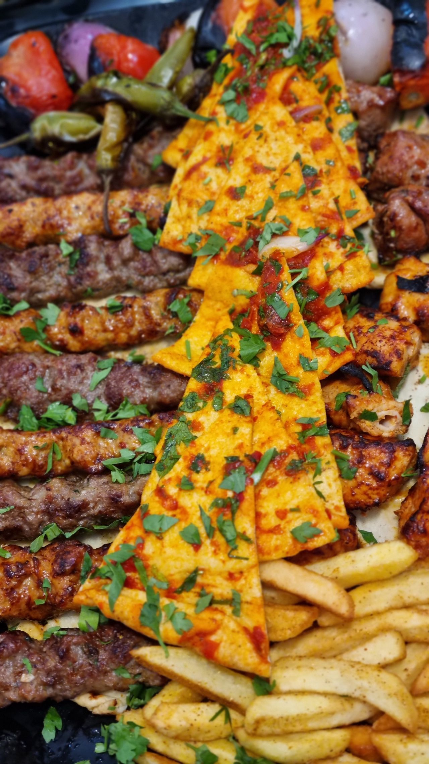
THE PLAN
Four moves for 2026
1
Lunch at Wayne
Open a weekday lunch service mirroring Main Street, with a fast pide and wrap menu.
2
Online ordering push
Promote the pickup menu and tune the checkout funnel with the volunteer engineer.
3
Catering from Wayne
Run corporate lunches out of the open kitchen to fill the slow midweek.
4
Loyalty for regulars
A simple repeat guest card, no app, run through the point of sale.
7 / 8

Slide 8
Target: close the Wayne gap by year end
Lift combined revenue toward $2.0M, pay off the $28,000 kitchen equipment loan by December, and bring Wayne food cost back toward 28%.
Reviewed monthly on the 15th with Frank Moretti.

